Slide 1
TOULMIN PARAGRAPHS
Made by Ms. Kohanim
Edited and added to by Ms. Ulrich

Slide 2
SHOULD I TAKE NOTES?

Slide 4
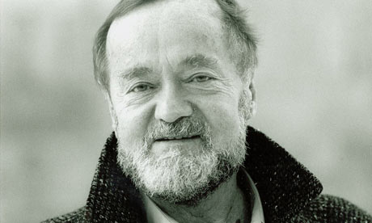
STEPHEN TOULMIN

Slide 5
British Philosopher

Slide 6
Worked at Oxford

Slide 7
Wrote: The Uses of Argument

Slide 8
Influenced by Ludwig Wittgenstein

Slide 9
TOULMIN PARAGRAPHS
ALSO KNOWN AS CDW’S
AT ITS MOST BASIC, IT HAS THREE PARTS: CLAIM, DATA, & WARRANT
REQUIRES “QUOTE WEAVING”

Slide 10
BASIC 3-PART CDW/ TOULMIN:
CLAIM
DATA
WARRANT
CLAIM
DATA
WARRANT

Slide 11
WE WILL START WITH THESE
C - D- W

Slide 12
CLAIM:
WHAT YOU CLAIM TO BE TRUE:
FACT: something is/ was/ will be
VALUE: something is good or bad
POLICY: something should or should not be done

Slide 13
DATA:
REASON BEHIND YOUR ARGUMENT:
QUOTE: line of text
(must be “quote-weaved”)
LOGIC: reasoning
ANECDOTAL: something you have personally observed

Slide 14
REVIEW: What is Quote Weaving?
(You have a handout already to help you with this…)
STEPS:
Context (give context for where/when the data is taken)
Attribution (who said/wrote it?)
The quote itself, followed by an in-text citation of author and pg #: (Bowden 46).
EXPLAIN THE IMPORTANCE OF THE QUOTE—this is the “warrant” we’ll talk about next

Slide 15
REVIEW: What is Quote Weaving?
STEPS:
Context (give context for where/when the data is taken)
Attribution (who said/wrote it?)
The quote itself, followed by an in-text citation of author and pg #: (Bowden 46).
The first two steps should come BEFORE step three and help integrate the quote INTO a sentence of your own words. NO QUOTE CAN STAND ALONE AS ITS OWN SENTENCE!

Slide 16
CAN I MAKE UP DATA?

Slide 18
WARRANT:
LINK DATA TO YOUR CLAIM:
HARDEST PART OF THE ARGUMENT
They explain how/ why your data proves your claim

Slide 19
EXAMPLE:
YOU DON’T HAVE TO WRITE THIS DOWN.
(IT WILL BE POSTED TO THE WEBSITE)
Claim: After school jobs create a negative experience for teens because they conflict with the essential goal of success In academics.
Data: Study time is essential to successful academic performance
Warrants: After school jobs subtract from essential study time and therefore retract from the overarching goal of academic success. Teens with after school jobs often do not have enough spare time to succeed at both a job and school. For that reason, students’ grades will drop or they will lose their job.

Slide 20
Did you notice?
Logic was used for data

Slide 21
Did you notice?
After school jobs subtract from essential study time and therefore retract from the overarching goal of academic success. Teens with after school jobs often do not have enough spare time to succeed at both a job and school. For that reason, students’ grades will drop or they will lose their job.
The warrant was more than one sentence

Slide 22
Can my warrant be one sentence long?

Slide 24
That is the 3-part Toulmin
Or C-D-W

Slide 25
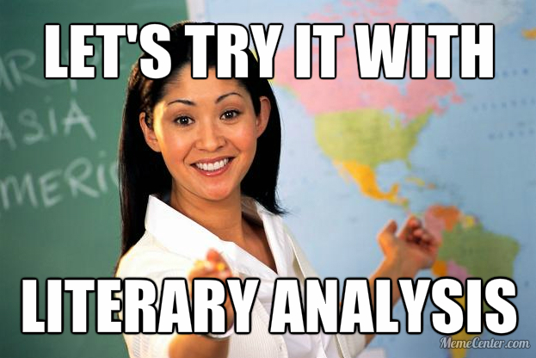

Slide 26
DO NOT

Slide 27
CLAIM:
In Edgar Allen Poe’s “Cask of Amontillado,” the ending is foreshadowed by Montressor’s malice towards Fortunato.

Slide 28
DATA:
Montressor reveals the malice he feels towards Fortunato when he says, “The thousand injuries of Fortunato I had borne as best I could, but when he ventured upon insult I vowed revenge” (5).

Slide 29
WARRANT:
The foreboding sound of “vowed revenge” suggests a deep malice. Montressor’s desire for revenge stems from the “thousand injuries” he has suffered, so this desire is not a passing frustration, but is instead a clear mark of malicious intent. As a result, the reader expects Montressor to make Fortunato suffer greatly at the end of the story as part of this revenge.

Slide 30
ALL TOGETHER:
In Edgar Allen Poe’s “Cask of Amontillado”, the ending is foreshadowed both by Montresor’s malice. Montresor reveals the malice he feels towards Fortunato when he says, “The thousand injuries of Fortunato I had borne as best I could, but when he ventured upon insult I vowed revenge” (5). The foreboding sound of “vowed revenge” suggests a deep malice. Montressor’s desire for revenge stems from the “thousand injuries” he has suffered, so this desire is not a passing frustration, but is instead a clear mark of malicious intent. As a result, the reader expects Montressor to make Fortunato suffer greatly at the end of the story as part of this revenge.

Slide 31
WE HAVE TO DO ALL THAT?

Slide 32
FOR ONE PARAGRAPH?

